Slide 1
SDLC

Slide 2
SOFTWARE DEVELOPMENT LIFE CYCLE (SDLC)
Software development life cycle (SDLC) - a structured step-by-step approach for developing Software systems
Typical activities include:
Determining budgets
Gathering business requirements
Designing models
Writing user documentation

Slide 3
SOFTWARE DEVELOPMENT LIFE CYCLE (SDLC)
SDLC PHASE | ACTIVITIES
Planning | Define the system to be developed Set the project scope Develop the project plan
Analysis | Gather business requirements
Design | Design the technical architecture Design system models
Development | Build technical architecture Build databases and programs
Testing | Write test conditions Perform testing
Implementation | Write user documentation Provide training
Maintenance | Build a help desk Support system changes

Slide 4
SOFTWARE DEVELOPMENT LIFE CYCLE (SDLC)
The SDLC has 7 phases:
Planning
Analysis
Design
Development
Testing
Implementation
Maintenance

Slide 5
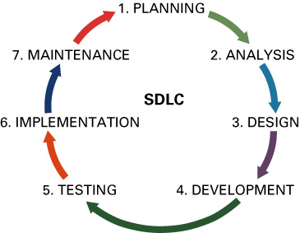
SOFTWARE DEVELOPMENT LIFE CYCLE (SDLC)

Slide 6
Phase 1: Planning
Planning phase - involves determining a solid plan for developing your information system
Three primary planning activities:
Define the system to be developed
Set the project scope
Project scope - clearly defines the high-level system requirements
Project scope document - a written definition of the project scope

Slide 7
Phase 1: Planning
Develop the project plan including tasks, resources, and timeframes
Project plan - defines the what, when, and who questions of system development
Project manager - an individual who is an expert in project planning and management, defines and develops the project plan and tracks the plan to ensure all key project milestones are completed on time
Project milestones - represent key dates for which you need a certain group of activities performed

Slide 8
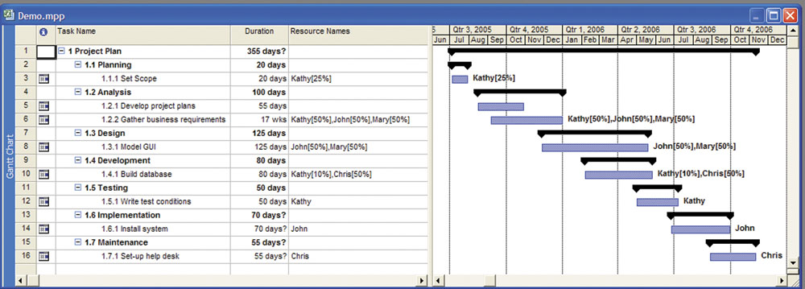
Phase 1: Planning

Slide 9
Phase 2: Analysis
Analysis phase - involves end users and IT specialists working together to gather, understand, and document the business requirements for the proposed system

Slide 10
Phase 2: Analysis
Two primary analysis activities:
Gather the business requirements
Business requirements - the detailed set of knowledge worker requests that the system must meet in order to be successful
Prioritize the requirements
Requirements definition document – prioritizes the business requirements and places them in a formal comprehensive document

Slide 11
Phase 3: Design
Design phase - build a technical blueprint of how the proposed system will work
Two primary design activities:
Design the technical architecture
Technical architecture - defines the hardware, software, and telecommunications equipment required to run the system
Design system models
Modeling - the activity of drawing a graphical representation of a design
GUI screen design - the ability to model the information system screens for an entire system

Slide 12
Phase 4: Development
Development phase - take all of your detailed design documents from the design phase and transform them into an actual system
Two primary development activities:
Build the technical architecture
Build the database and programs
Both of these activities are mostly performed by IT specialists

Slide 13
Phase 5: Testing
Testing phase - verifies that the system works and meets all of the business requirements defined in the analysis phase
Two primary testing activities:
Write the test conditions
Test conditions - the detailed steps the system must perform along with the expected results of each step

Slide 14
Phase 5: Testing
Perform the testing of the system
Unit testing – tests individual units of code
Integration testing – verifies that separate systems work together - functional aspects of the integrated components
System testing – verifies that the units of code function correctly when integrated for functional and non-functional requirements(performance, usability etc).
User acceptance testing (UAT) – determines if the system satisfies the business requirements

Slide 15
Phase 6: Implementation / Deployment
Implementation phase - distribute the system to all of the knowledge workers and they begin using the system to perform their everyday jobs
Two primary implementation activities
Write detailed user documentation
User documentation - highlights how to use the system
Provide training for the system users
Online training - runs over the Internet or off a CD-ROM
Workshop training - is held in a classroom environment and lead by an instructor

Slide 16
Phase 6: Implementation
Choose the right implementation method
Parallel implementation – use both the old and new system simultaneously
Plunge implementation – discard the old system completely and use the new
Pilot implementation – start with small groups of people on the new system and gradually add more users
Phased implementation – implement the new system in phases

Slide 17
Phase 7: Maintenance
Maintenance phase - monitor and support the new system to ensure it continues to meet the business goals
Two primary maintenance activities:
Build a help desk to support the system users
Help desk - a group of people who responds to knowledge workers’ questions
Provide an environment to support system changes

